Slide 1
Legal Aspects of Social Enterprise
Online AICTE Training & Learning (ATAL) Faculty Development Programme on Social Enterprise Management
organised by
Gujarat National Law University, Gandhinagar
August 5, 2021
Dr. Kalpeshkumar L Gupta
Associate Professor of Law, Parul University & Founder of ProBono India, Legal Startups
www.legalstartups.info

Slide 2
Agenda
Introduction
Legal Aspects involved in Social Enterprise
My story
klgupta.in

Slide 3
Agenda
Introduction
Legal Aspects involved in Social Enterprise
My story
klgupta.in

Slide 4
1. Introduction
klgupta.in

Slide 5
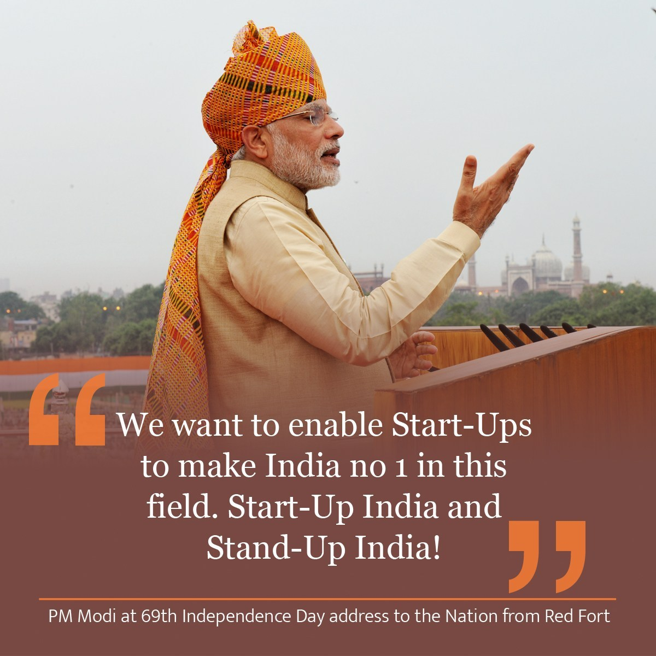
The campaign was first announced by Indian Prime Minister, Narendra Modi during his 15 August 2015 address from the Red Fort, in New Delhi.
The action plan of this initiative, is based on the following three pillars:
1. Simplification and Handholding.
2. Funding Support and Incentives.
3. Industry-Academia Partnership and Incubation.
Cont…
klgupta.in

Slide 6
MINISTRY OF COMMERCE AND INDUSTRY (Department of Industrial Policy and Promotion) NOTIFICATION New Delhi, the 11th April, 2018
An entity shall be considered as a Startup:
i. Upto a period of 10 years from the date of incorporation/registration,
if it is incorporated as a Private Limited Company (as defined in the Companies Act, 2013) or registered as a Partnership Firm (registered under section 59 of the Partnership Act, 1932) or a Limited Liability Partnership (under the Limited Liability Partnership Act, 2008) in India.
ii. Turnover of the entity for any of the financial years since incorporation/ registration has not exceeded Rs. 100 crore
iii. Entity is working towards innovation, development or improvement of products or processes or services, or if it is a scalable business model with a high potential of employment generation or wealth creation.
Cont…
https://dipp.gov.in/sites/default/files/Startup_Notification11April2018_0.pdf
klgupta.in

Slide 7
Cont…
MINISTRY OF COMMERCE AND INDUSTRY (Department of Industrial Policy and Promotion) NOTIFICATION New Delhi, the 11th April, 2018
Provided that an entity formed by splitting up or reconstruction of an existing business shall not be considered a ‘Startup’.
Explanation
An entity shall cease to be a Startup on completion of 10 years from the date of its incorporation/ registration or if its turnover for any previous year exceeds Rupees 100 crore.
https://dipp.gov.in/sites/default/files/Startup_Notification11April2018_0.pdf
klgupta.in

Slide 8
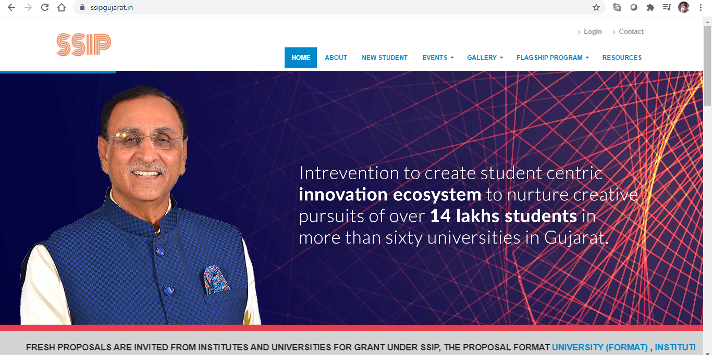
https://www.ssipgujarat.in/
klgupta.in

Slide 9
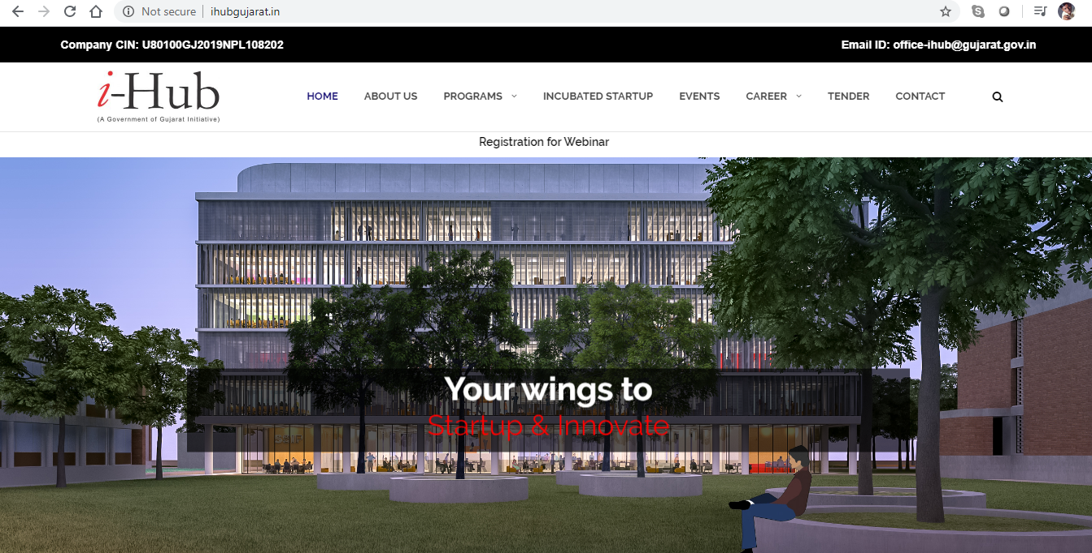
Example :- i-Hub set up by Govt. of Gujarat
Gujarat Student Startup and Innovation Hub, registered under Section 8 of the companies Act 2013, is envisioned to be a nexus for all Startup stakeholders to develop an end-to-end innovation and entrepreneurial ecosystem in the State of Gujarat by creating pathways from “Mind-to-Market”. i-hub is a vibrant incubation setup established under SSIP by the Education Department, Government of Gujarat.
klgupta.in
http://ihubgujarat.in/

Slide 10
Gujarat best state in providing strong ecosystem for startups: Dept of Industrial Policy & Promotion ranking
2018 Startup State Ranking are as follows:
Best performer: Gujarat
Top performers: Karnataka, Kerala, Odisha, and Rajasthan
Leader: Andhra Pradesh, Bihar, Chhattisgarh, Madhya Pradesh, and Telangana
Aspiring leaders: Haryana, Himachal Pradesh, Jharkhand, Uttar Pradesh, and West Bengal
Emerging states: Assam, Delhi, Goa, Jammu & Kashmir, Maharashtra, Punjab, Tamil Nadu, and Uttarakhand
Beginners: Chandigarh, Manipur, Mizoram, Nagaland, Puducherry, Sikkim, and Tripura
https://economictimes.indiatimes.com/small-biz/startups/newsbuzz/gujarat-best-state-in-providing-strong-ecosystem-for-startups-dipp-ranking/articleshow/67176184.cms
klgupta.in

Slide 11
Gujarat best state in providing strong ecosystem for startups: Dept of Industrial Policy & Promotion ranking
2019 Startup State Ranking are as follows:
Best performer: Gujarat
Top performers: Karnataka, Kerala
Leader: Maharashtra, Bihar, Odisha, Rajasthan
Aspiring leaders: Punjab, Telangana, Uttarakhand, Jharkhand, Haryana
Emerging states: Chhatisrgarh, Uttar Pradesh, Tamil Nadu, Sikkim, Nagaland, Mizoram, Madhya Pradesh, Assam
S
klgupta.in

Slide 12
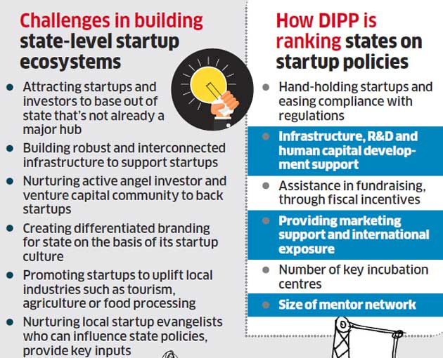
Gujarat best state in providing strong ecosystem for startups: Dept of Industrial Policy & Promotion ranking
Regulations
klgupta.in

Slide 13
Agenda
Introduction
Legal Aspects involved in Social Enterprise
My story
klgupta.in

Slide 14
2. Legal Aspects Involved in Social Enterprise
klgupta.in

Slide 15
2. Legal Aspects Involved in Social Enterprise
2.1 Primary Compliances e.g. local bodies permission
2.2 Primary Agreements
2.3 Forms of Business
2.4 Intellectual Property Rights
2.5 Taxation
2.6 Labour Laws
2.7 Sectoral Regulation Compliances e.g. Councils, Authorities
2.8 Special permission
klgupta.in

Slide 16
2. Legal Aspects Involved in Social Enterprise
2.1 Primary Compliances e.g. local bodies permission
Shops & Establishment Act
klgupta.in

Slide 17
2. Legal Aspects Involved in Social Enterprise
2.2 Primary Agreements
klgupta.in

Slide 18
2. Legal Aspects Involved in Social Enterprise
2.3 Forms of Business
1. Sole Proprietorship
2. Partnership (Partnership Act, 1932)
3. Limited Liability Partnership (LLP Act, 2008)
4. Company (Companies Act, 2013)
5. Public Trust/Society (Indian Trust Act, 1882/Societies
Registration Act, 1860/State Cooperative Societies
Act)…. NGO
klgupta.in

Slide 19
2. Legal Aspects Involved in Social Enterprise
2.3 Forms of Business
klgupta.in

Slide 20
2. Legal Aspects Involved in Social Enterprise
2.3 Forms of Business
For Profit | Not for profit
Sole Proprietorship | Sole Proprietorship
Partnership Firm | Partnership Firm
LLP | LLP
Companies Pvt. Ltd. Co. One Person Co. (Pvt Ltd.) Public Ltd. Co. | Companies Pvt. Ltd. Co. One Person Co. (Pvt Ltd.)..not as a Section 8 Co. Public Ltd. Co. Section 8 Co – Not for Profit Co.
 | Trust
 | Society
*CSR, Section 135 of Companies Act, 2013, Schedule 7
klgupta.in

Slide 21
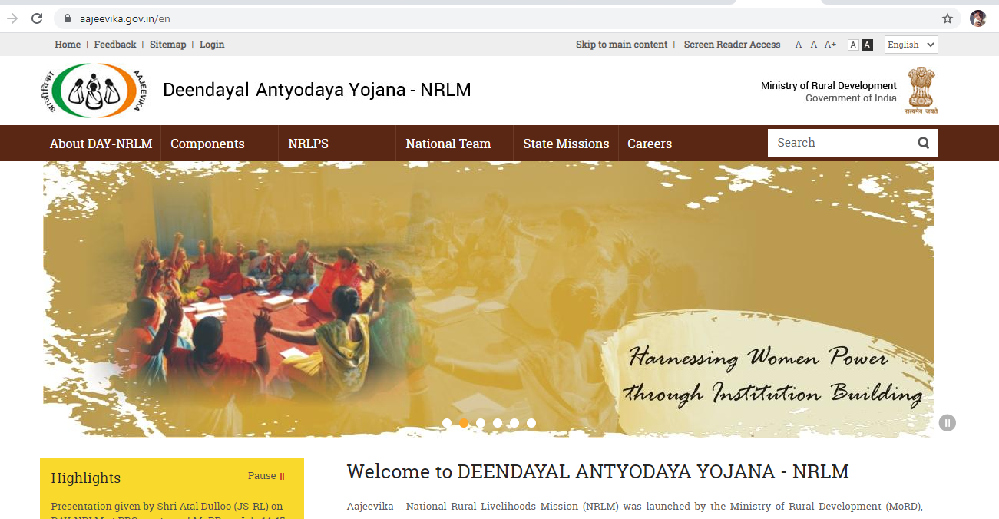
2. Legal Aspects Involved in Social Enterprise
2.3 Forms of Business
Aajeevika - National Rural Livelihoods Mission (NRLM) was launched by the Ministry of Rural Development (MoRD), Government of India in June 2011.
klgupta.in

Slide 22
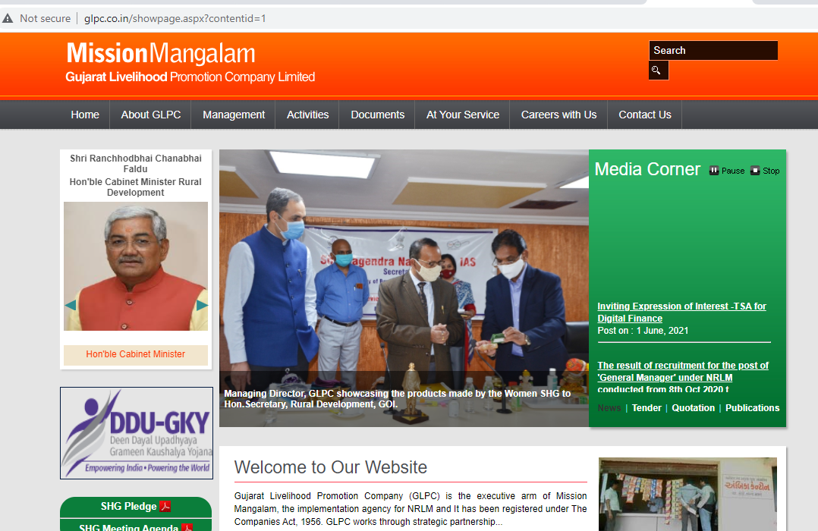
2. Legal Aspects Involved in Social Enterprise
2.3 Forms of Business
Registered under The Companies Act, 1956.
April 21, 2010
klgupta.in

Slide 23
2. Legal Aspects Involved in Social Enterprise
2.3 Forms of Business
Gujarat Livelihood Promotion Company (GLPC) is the executive arm of Mission Mangalam, the implementation agency for NRLM. It has been registered under The Companies Act, 1956 on April 21, 2010.
GLPC works through strategic partnership between large industries and SakhiMandals/Self Help Groups/Producer Groups/Service Groups/ Collectives of the poor, through decentralized Micro Enterprise Ventures. The promoting companies/entrepreneurs redesign the process where intensive tasks as job-works are undertaken by Self Help Groups in their respective homes or villages as self-employment activities. Main objectives of GLPC are
Empowering the Poor by organizing them into SHGs/Federations/other Collectives.
Empower the poor through ensuring access to Financial Services.
Augmenting existing livelihoods and enhancing incomes
Explore livelihood opportunities through newer ventures in rural service sector
Developing Inclusive Value Chains
klgupta.in

Slide 24
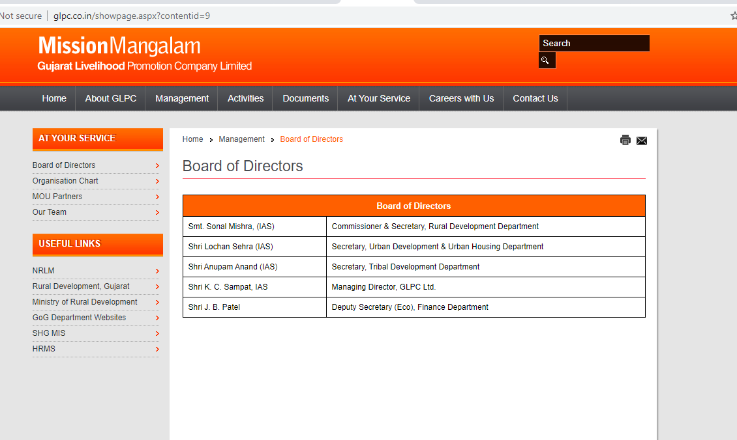
2. Legal Aspects Involved in Social Enterprise
2.3 Forms of Business
klgupta.in

Slide 25
2. Legal Aspects Involved in Social Enterprise
2.4 Intellectual Property Rights
klgupta.in

Slide 26
2. Legal Aspects Involved in Social Enterprise
2.5 Taxation
Direct Tax
Income Tax
Indirect Tax
GST
Custom
klgupta.in

Slide 27
2. Legal Aspects Involved in Social Enterprise
2.6 Labour Laws
Factories Act
Industrial Dispute Act
Minimum Wages Act
Workman Compensation Act
Gratuity Act
Provident Fund
Prevention of Sexual Harassment of Women at Workplace etc.
klgupta.in

Slide 28
2. Legal Aspects Involved in Social Enterprise
2.7 Sectoral Regulation Compliances e.g. Councils, Authorities
Pharmacy Council
Medical Council
Bar Council of India
FSSAI (Food) Food Safety & Standard Act, 2006
klgupta.in

Slide 29
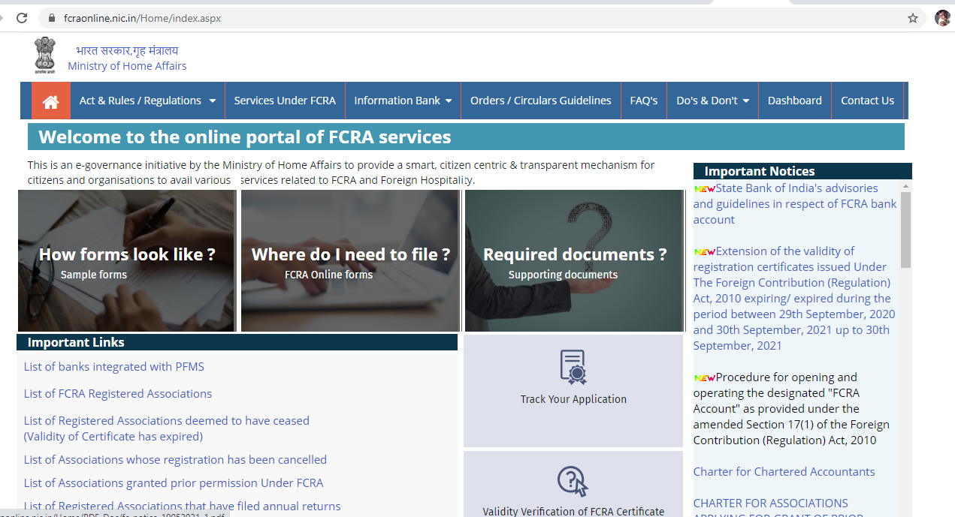
2. Legal Aspects Involved in Social Enterprise
2.8 Special Permission
e.g. Foreign Donation, permission under Foreign Contribution Regulation Act, 2010
klgupta.in

Slide 30
2. Legal Aspects Involved in Social Enterprise
2.8 Special Permission
FCR Act
klgupta.in

Slide 31
Agenda
Introduction
Legal Aspects involved in Social Enterprise
My story
klgupta.in

Slide 32
3. My Story
klgupta.in

Slide 33
My Story
2021
2016
2018
klgupta.in
legalstartups.info
law-teachers.in
2016
2019
probono-india.in
courtmanagement.in
klgupta.in

Slide 34
Dr. Kalpeshkumar L Gupta
www.klgupta.in
Mob. 99248 97691

